Slide 1


SIMATS ENGINEERING
SAVEETHA INSTITUTE OF MEDICAL AND TECHNICAL SCIENCES
Capstone project presentation
Intelligent Emergency Vehicle Priority System for Driveway Traffic Control
Team - 3
EEA0117 - Basic Electrical and Electronics Engineering for Home Automation Instrumentation
Presented by:
Guided By
Dr. Valentina Stephen & Dr. R. Sivakumar
E.Shashank Narayana (192312507)
M.Yugandhar (192372016)
P.MalReddy (192372015)
Athish.E(192371015)
P.Sravani (192311135)

Slide 2
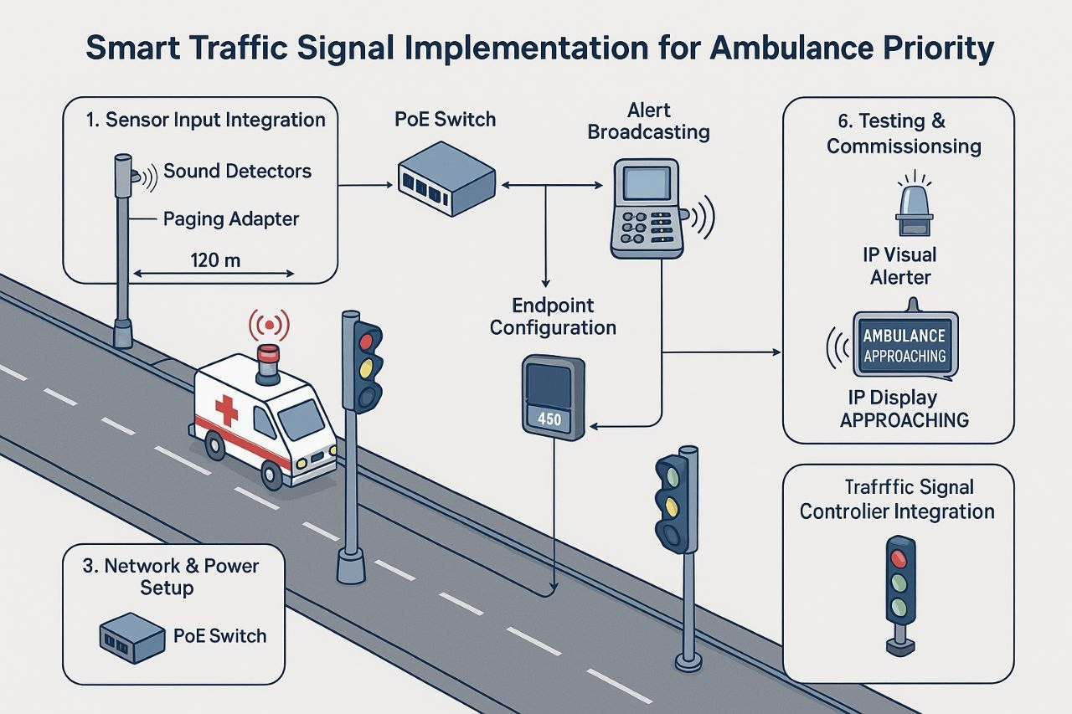
ABSTRACT
The Intelligent Emergency Vehicle Priority System for Driveway Traffic Control is designed to reduce response time for emergency vehicles such as ambulances, fire engines, and police vehicles by providing automatic traffic priority. Traditional traffic systems do not dynamically adapt to emergency situations, leading to congestion and delays.

Slide 3
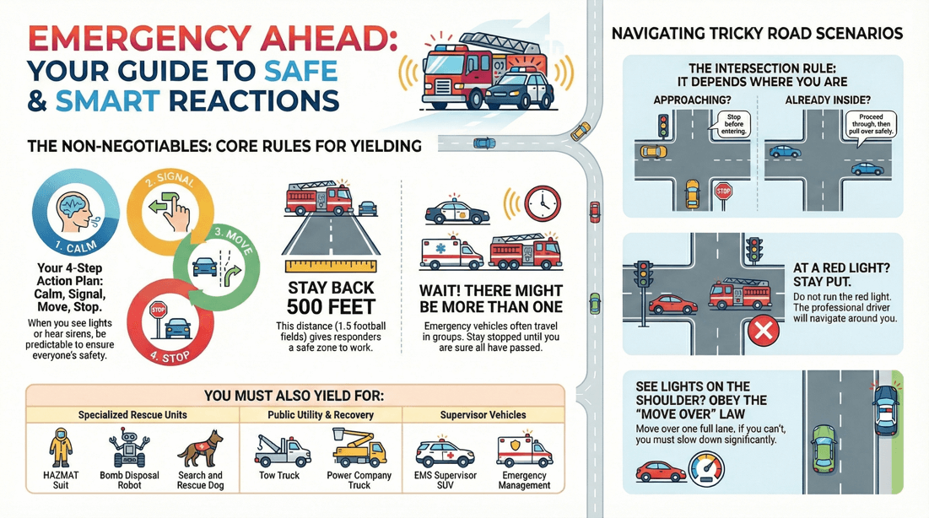
OBJECTIVES
To detect approaching emergency vehicles in real time
To provide automatic traffic priority at driveways
To reduce emergency response time
To minimize manual traffic control
To improve safety and traffic flow efficiency

Slide 4
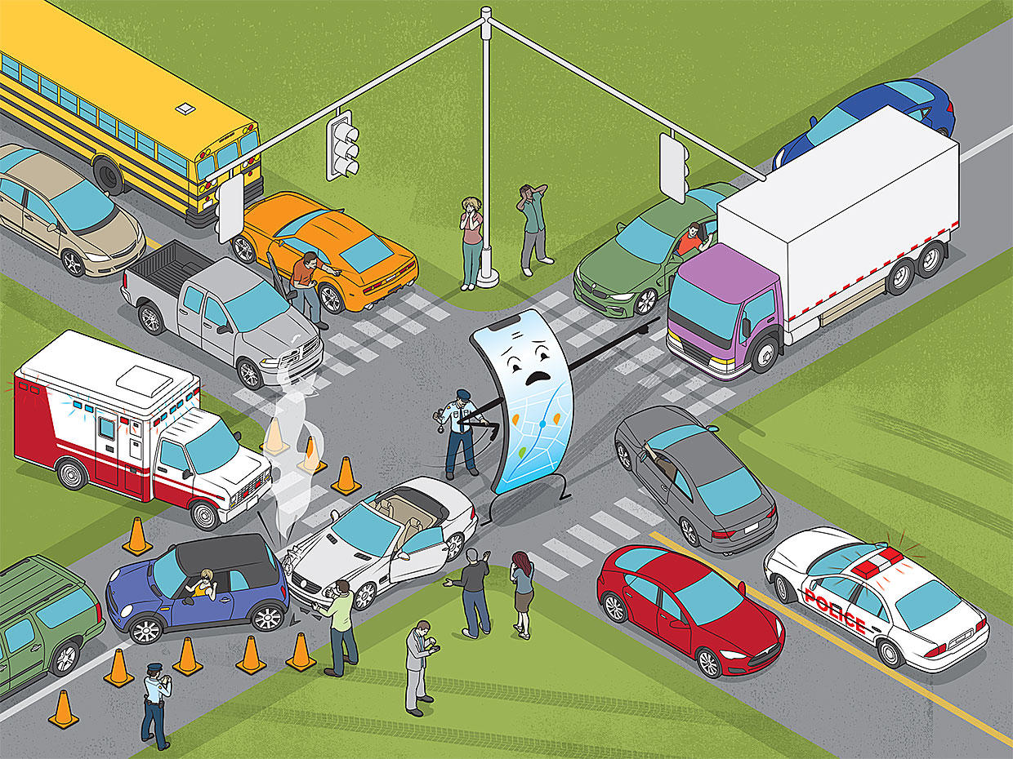
PROBLEM STATEMENT
Emergency vehicles often face delays at residential driveways, parking exits, and private road intersections due to uncontrolled or manually operated traffic systems. Lack of real-time detection and automated priority mechanisms leads to increased response time, which can be critical during emergencies. An intelligent and automated traffic control system is required to ensure smooth and immediate passage for emergency vehicles.

Slide 5
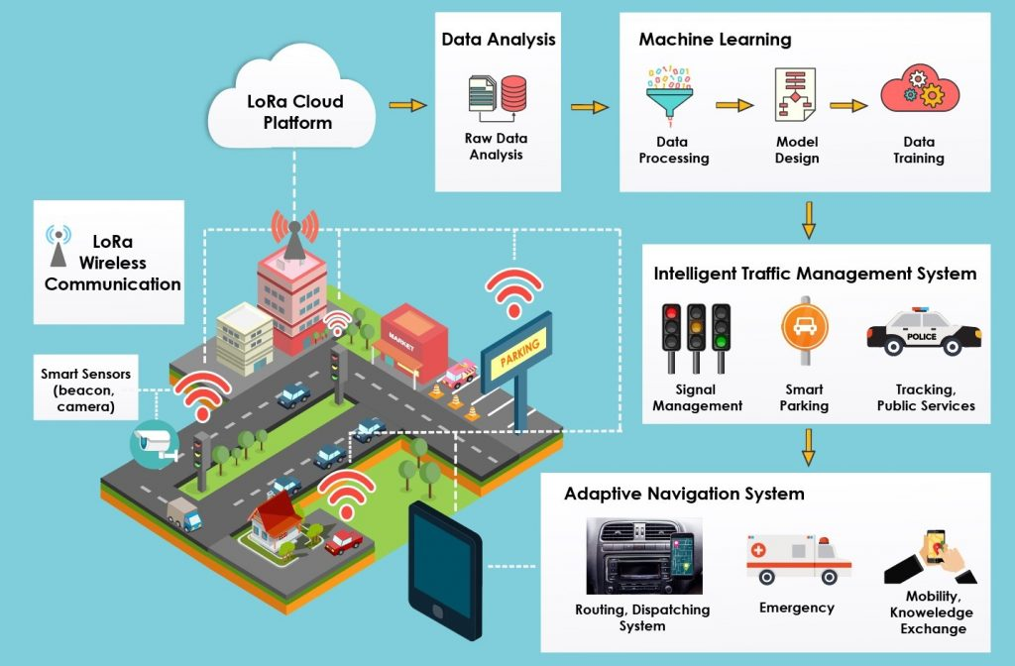
INTRODUCTION
Efficient traffic management is essential, especially for emergency response systems. In residential complexes, hospitals, and private driveways, traffic congestion can obstruct emergency vehicles. With advancements in embedded systems and wireless communication, intelligent traffic control systems can dynamically prioritize emergency vehicles.

Slide 6
METHODOLOGY
Detect emergency vehicle using sensors or RF modules
Transmit detection signal to the control unit
Process data using a microcontroller
Override normal traffic signal operation
Provide green signal or open driveway gate
Restore normal traffic flow after vehicle passes

Slide 7
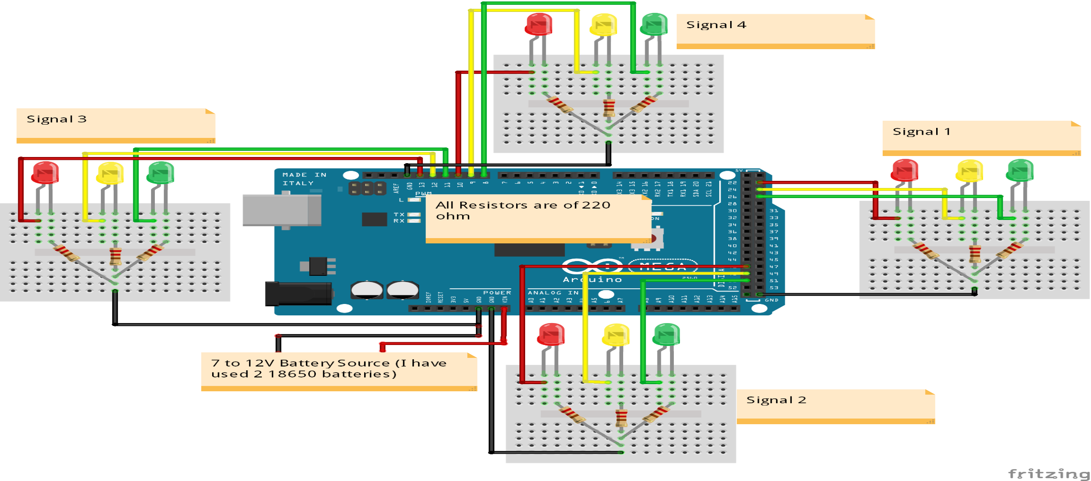
SYSTEM DESIGN/ BLOCK DIAGRAM & CIRCUIT DIAGRAM

Slide 8
HARDWARE USED & COST ANALYSIS
S.No | Hardware Component | Quantity | Approx. Cost (INR)
1 | ESP 32 | 2 | ₹1200
2 | Sound Detection Sensor | 4 | ₹800
3 | RF Transmitter Module | 1 | ₹350
4 | RF Receiver Module | 1 | ₹360
5 | LEDs (Red, Yellow, Green) | 12 | ₹120
6 | 16×2 LCD Display | 4 | ₹1000
7 | Resistors & Jumper Wires | As required | ₹100
8 | Breadboard | 1 | ₹150
9 | Power Supply | 1 | ₹200
Total Cost |  |  | ₹4380 (Approx.)

Slide 9
MODULE 1: Smart Traffic Signal Control System
Implements an automated four-way traffic junction
Uses ESP32-A as the central traffic controller
Cycles traffic lights in North, East, South, West directions
Manages Green → Yellow → Red timing sequence
Reduces manual intervention and improves traffic discipline
Provides a base framework for intelligent traffic systems

Slide 10
MODULE 2: Multi-Display Information System (OLED + I²C Multiplexer)
Uses ESP32-B as a dedicated display controller
Integrates 4 I²C OLED displays for four directions
Employs TCA9548A I²C multiplexer to avoid address conflicts
Displays real-time traffic status and countdown timers
Shows emergency alerts and guidance messages
Ensures stable and synchronized display updates

Slide 11
MODULE 3: Emergency Vehicle Detection Using Sound Sensors
Deploys sound sensors in all four directions
Detects ambulance siren patterns near the junction
Identifies the direction of the emergency vehicle
Triggers priority handling before the vehicle reaches the signal
Reduces response delay for emergency services
Enhances road safety and saves critical time

Slide 12
MODULE 4: RF-Based Emergency Confirmation System
Uses RF transmitter installed in the ambulance
Uses RF receiver connected to ESP32-A at the junction
Confirms the actual arrival of the emergency vehicle
Filters noise using time-based RF signal validation
Prevents false emergency triggers
Ensures reliable and intentional emergency clearance

Slide 13
MODULE 5: Intelligent Priority & Recovery Logic
Automatically creates a green corridor for ambulances
Blocks all other directions during emergency passage
Displays “PLEASE GIVE WAY” messages on OLEDs
Detects ambulance exit using opposite-direction sound sensors
Restores normal traffic flow after emergency passes
Uses a state-machine-based control algorithm for stability

Slide 14
RESULTS & DISCUSSION
The system successfully detected emergency vehicle sirens using sound sensors.
RF transmitter in the ambulance and RF receiver at the signal ensured reliable priority communication.
Arduino accurately identified the direction of the approaching emergency vehicle.
The corresponding signal turned GREEN, while other three directions remained RED.
LCD display clearly showed emergency status and active signal direction.

Slide 15
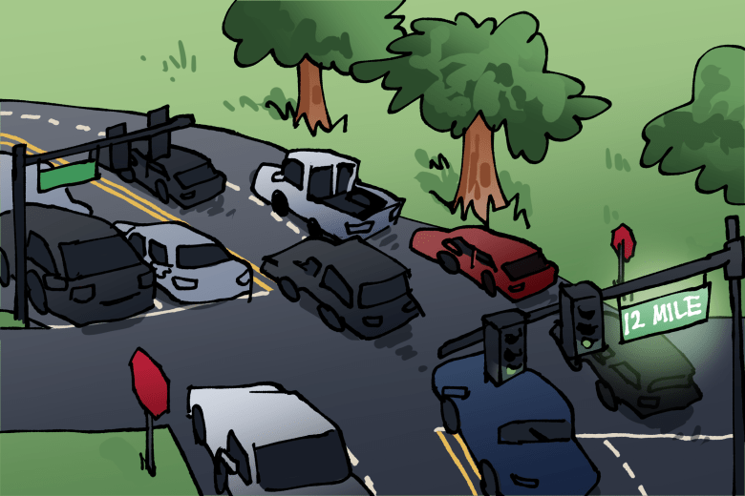
CHALLENGES & LIMITATIONS
Sound sensors may falsely trigger due to loud noises like horns or sirens from non-emergency vehicles.
RF communication range is limited and may be affected by obstacles or interference.
The system is suitable mainly for small-scale or controlled junctions.
Sensor accuracy depends on proper placement and calibration.
Multiple emergency vehicles arriving simultaneously cannot be handled efficiently.

Slide 16

CONCLUSION & FUTURE SCOPE
CONCLUSION
The proposed system successfully provides priority to emergency vehicles at a four-way traffic junction.
Integration of Arduino, sound sensors, RF communication, LEDs, and LCD ensured reliable operation.
Emergency vehicle detection and direction identification were achieved accurately.
Traffic signals were automatically controlled without human intervention.
The system reduced emergency vehicle waiting time and improved road safety.
The design is cost-effective and suitable for small-scale real-time applications.
FUTURE SCOPE
Integration of GPS-based vehicle tracking for precise emergency detection.
Use of AI and image processing for visual vehicle recognition.
IoT and cloud connectivity for centralized traffic monitoring.
Mobile application for traffic authorities and emergency services.
Expansion to city-wide smart traffic management systems.
Solar power integration for energy efficiency.

Slide 17
REFERENCES
□
Siddiqi et al. (2025) — An intelligent traffic control system integrating RF communication with Arduino for emergency vehicle priority at intersections.
Traffic Congestion and Emergency Vehicle Responsive Traffic Signal Control (2023) — Adaptive traffic signal system using sound sensors and real-time camera data for emergency vehicle prioritization.
Integrated AI Model for Traffic Density Management and Emergency Vehicle Prioritization (2025) — Combines computer vision, audio recognition and RFID for emergency vehicle prioritization.
Vacalebri-Lloret et al. (2025) — AI-powered emergency sound detection and localization for road safety enhancement.
Intelligent Traffic Signalling Priority System for Ambulance and VIP Vehicles (2025) — RFID and sensor-based priority system for four-way traffic intersections.

Slide 18


